Slide 1

Hadoop-as-a-Service (HDaaS)
Flexible und skalierbare Referenzarchitektur
Lena Frank – Systems Engineer @ EMC
Marius Lohr – Systems Engineer @ EMC

Slide 2

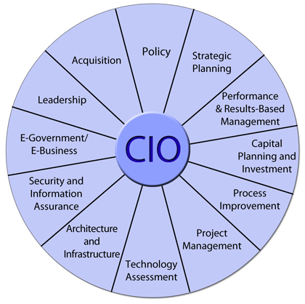

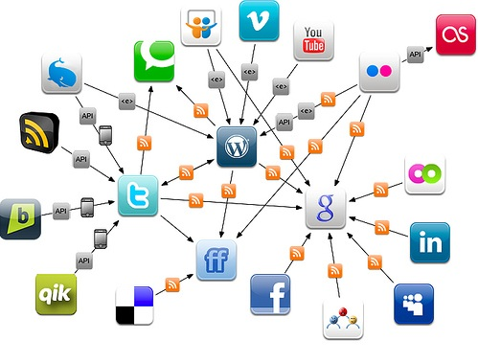




Fallbeispiel: CIO eines DAX Unternehmens
klassische IT Dienste:
neue IT Dienste:

Slide 3

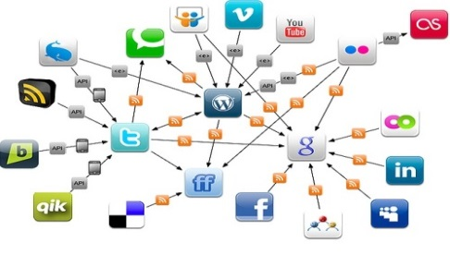
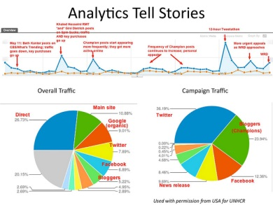

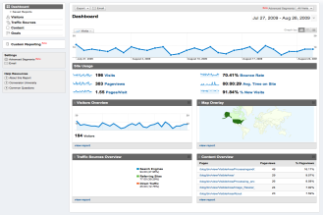
Die Möglichkeiten
neue Geschäftsfelder
Risikominimierung
Umsatzsteigerung
Verbesserung operatives Geschäft
hjdfhjdsfh

Slide 4

Die Herausforderungen
Kostendruck ggü. Cloud Anbietern
Fehlendes Wissen über Hadoop Infrastrukturen
Schnelles Deployment
Anforderungen und Workloads
mehrere Mandanten
Hochverfügbarkeit und Datensicherheit

Slide 5








Klassische Hadoop Architektur
Sqoop
PIG
Mahout
Hive
HBase
NameNode
Job Tracker
Task Tracker
DataNode
2nd NameNode
Data Node + Compute Node
Data Node + Compute Node
Data Node + Compute Node
Ethernet
NameNode
Data Node + Compute Node
Data Node + Compute Node
Data Node + Compute Node

Slide 6
Klassische Hadoop Architektur
dedizierte Serverumgebung mit lokalem Storage Hardware und Kapazität nur für Hadoop Daten gedacht
Effizienz schlechte CPU Auslastung da auf Lastspitzen zugeschnitten 3-fach Spiegelung (300% Brutto) durch Hadoop Architektur
Skalierungsmöglichkeiten starres Verhältnis von Compute Node zu Data Node
Enterprise Class Dienste Fehlende Datensicherungskonzepte wie Snapshots, Replikation, Backup Keine logische Trennung von Mandanten
Notes:
One challenge associated with traditional deployments of Hadoop, is that it has largely been done on a dedicated infrastructure and not integrated with or connected to any other applications. In effect, a silo’d environment, often outside the realm of the IT team. This poses a number inefficiencies and risks.
<Click to next slide>

Slide 7

Hadoop Architektur mit konsolidiertem HDFS Storage
Sqoop
Mahout
Hive
HBase
NameNode
PIG
Job Tracker
Task Tracker
DataNode
HDFS
Compute Node
Compute Node
Compute Node
Ethernet
name node
data node
Compute Node
Compute Node
Compute Node

Slide 8
Project Serengeti
Open-Source Projekt
Schnelles Deployment von Hadoop Clustern in virtuellen Umgebungen
VM
VM
VM
VM
vCenter
Management Server
Templates
Hadoop Node
Hadoop Node
vSphere + Serengeti
Host
Host
Host
Host

Slide 9
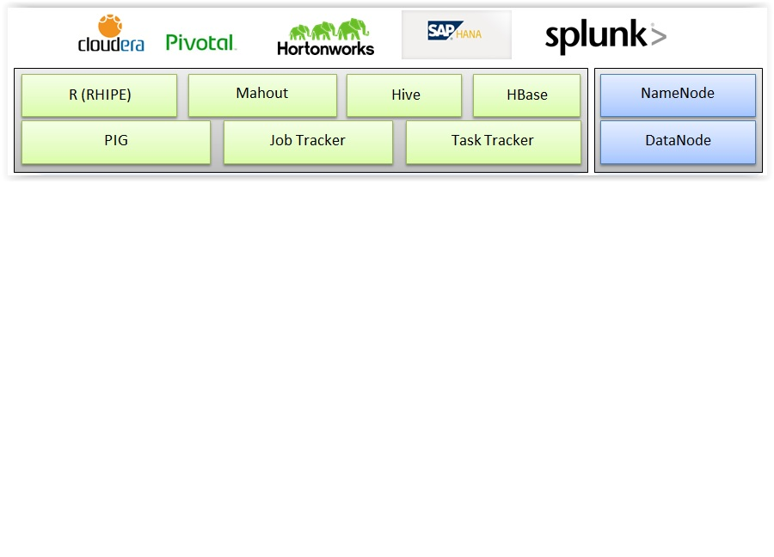


Hadoop-as-a-Service Referenzarchitektur
Self Service Portal
Serengeti
Orchestration & Chargeback
User Management
Hadoop
virtuell
Compute Node
Compute Node
Compute Node
vCenter
physikalisch
HDFS
Name node
data node
Infrastructure Mgmnt

Slide 10



HDaaS Workflow
Data Scientist
7: Access and Analyze
1: Request
6: Notify
PIVO-TAL HD MASTER
Hadoop Cluster
HD
WORKER
PIVO-TAL HD MASTER
HD
WORKER
6: Notify
SELF SERVICE
PORTAL
3: Invoke
ORCHESTRATOR
SERENGETI
4b: Provision
Compute
5: Instantiate
2: Validate
4a: Provision Storage
USER/
TENANT MGMT
HDFS/ REST API
Shared HDFS Storage
AD
Notes:
How the environment works:
A data scientist has a new workflow task:
They make a request through the portal webpage for a new cluster resource
The vCAC service broker asks the authentication source is the user making the request is ok to proceed
vCAC sends it on to vCOPS to instantiate all the calls to storage, BDE, and resource profiles to make sure it can be configured in the existing environment
If so the resources are provisioned
BDE configures the Hadoop environment(s)
Notification is passed back through vCOPS and surfaced to the user
The user can now access the new environment and run their jobs

Slide 11

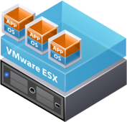
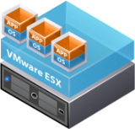
Vorteile einer entkoppelten und virtualisierten Hadoop Infrastruktur
unabhängige Skalierung der Infrastruktur Compute und Data Nodes voneinander unabhängig erweiterbar
bessere Ausnutzung der IT Infrastruktur >80% Storage Utilization, verbesserte CPU Utilization parallele Workloads von non-Hadoop Applikationen auf gleicher Hardware
automatisierte Bereitstellung und einfaches Management konsolidierter HDFS Speicher Compute Templates als Basis für schnelles Deployment
Mandantentrennung Logische Trennung der Datenzugriffe Logische Trennung der Compute Nodes
zusätzlicher Schutz der Daten Snapshots, Replikation, Backup
Data Scientist
HDFS
Virtualisierte Hadoop Cluster
Shared HDFS Storage
Hadoop-as-a-Service
Referenzarchitektur
Notes:
EMC Isilon has recently introduced a new scale-out NAS solution for Hadoop that is designed to readily support business analytics as well other enterprise applications and workflows. (This eliminates the silo’d infrastructure approach used in many initial Hadoop deployments.)
The new EMC solution also eliminates the “single-point-of-failure” issue. We do this by enabling all nodes in an EMC Isilon storage cluster to become, in effect, namenodes. This greatly improves the resiliency of your Hadoop environment.
The EMC solution for hadoop also provides reliable, end-to-end data protection for Hadoop data including snapshoting for backup and recovery and data replication (with SyncIQ) for disaster recovery capabilities.
Our new Hadoop solution also takes advantage of the outstanding efficiency of EMC Isilon storage systems. With our solutions, customers can achieve up to 80% or more storage utilization.
EMC Hadoop solutions can also scale easily and independently. This means if you need to add more storage capacity, you don’t need to add another server (and vice versa). With EMC isilon, you also get the added benefit of linear increases in performance as the scale increases.
EMC also recently announced that we are the 1st vendor to integrate the HDFS (Hadoop Distributed File System) into our storage solutions. This means that with EMC Isilon storage, you can readily use your Hadoop data with other enterprise applications and workloads while eliminating the need to manually move data around as you would with direct-attached storage.

Slide 12

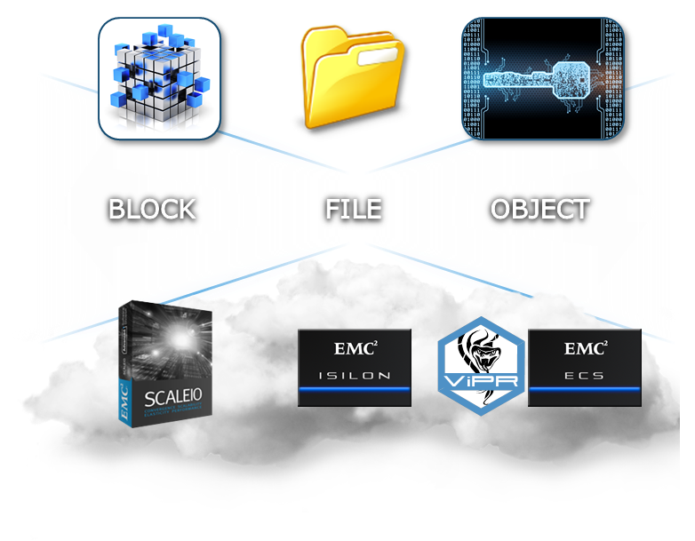















EMC Scale-Out Data Lake Foundation
TRADITIONAL WORKLOADS
Data Lake Foundation
NEXT-GEN WORKLOADS
NAS
DAS
File Shares
Analytics
SAN
CLOUD
HPC
Mobile
TAPE
OBJECT
Backup/Archive
Cloud Apps
© Copyright 2014 EMC Corporation. All rights reserved.
© Copyright 2014 EMC Corporation. All rights reserved.
12

Slide 13
EMC Scale-Out Data Lake Foundation
TRADITIONAL WORKLOADS
Data Lake Foundation
NEXT-GEN WORKLOADS
NAS
DAS
File Shares
Analytics
SAN
Data Lake Foundation
CLOUD
HPC
Mobile
TAPE
OBJECT
Backup/Archive
Cloud Apps
© Copyright 2014 EMC Corporation. All rights reserved.
© Copyright 2014 EMC Corporation. All rights reserved.
13

Slide 14














Next-Gen Access Methods
SMB
HDFS
FILE
File Shares
Analytics
FTP
REST
FILE
HPC
Mobile
NFS
SWIFT
NDMP
HTTP
Backup/Archive
Cloud Apps
© Copyright 2014 EMC Corporation. All rights reserved.
© Copyright 2014 EMC Corporation. All rights reserved.
14
Notes:
Key Message:
- This is not a placid data lake where data goes in and just sits.
(CLICK) This is an active and vibrant data lake that supports multiple protocols and access methods.
(CLICK) So when a file moves from a file share in to this data lake it can be actively used (click) and leveraged by all the applications..
An example here is that the files in this unstructured data lake can be cross correlated from multiple sources to perform hadoop big data analytics on it to garner valuable business insights. The same set of files can be accessed using Syncplicity in your iphone or ipad for access on the go.
In addition to the business benefits of consolidating the unstructured data, the Isilon scale out data lake also eliminates silos of storage, provides simplified management and scales massively to meet the demands of unstructured data growth

Slide 15



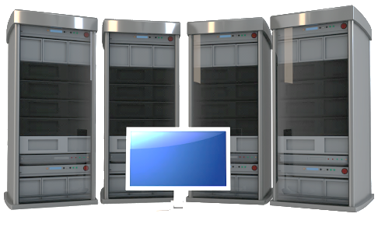


Expanded Enterprise-Grade Features
Isilon
Data Lake
Foundation
DATA PROTECTION
DATA MANAGEMENT
DATA SECURITY
PERFORMANCE MANAGEMENT
© Copyright 2015 EMC Corporation. All rights reserved.
15
Notes:
Further, this is a fully enterprise ready Scale out data lake – we have a vast array of enterprise grade features spanning data protection, data security, data management and performance management that ensures that the data lake stores, protect, secures and manage your data with ease.
New features include a new protection policy for higher capacity nodes
A protection optimizer that constantly monitors and alerts when protection drops below suggested leve
NFS audit
NFS multi-tenancy (to complement SMB and Hadoop capabilities)
New InsightIQ for better reporting and tracking
SmartFlash on all archive platforms for increased system performance

Slide 16
Haben Sie noch Fragen?

